Slide 1

Dr. Kurt Engelmann
July 10, 2013
Notes:
Thank you very much. Great to be here and wonderful to talk to such dedicated practitioners of DI who are committed to helping all children succeed. The Elementary Teachers Academy is a great mechanism for teachers to improve their skills and effectiveness with DI at the same time that needy students receive instruction that can help boost their performance in preparation for the coming school year. I want to thank the organizers of the ETA in general and this event in particular for having me here.
You may have seen me in your classrooms this week. I’ve only been able to go to a few campuses. My pleasure to observe the teaching and learning that’s going on.
As I’ve gone into classrooms, I’ve conducted some informal observations. You may have seen me taking notes, and perhaps you’ve wondered what I and other coaches are looking at and looking for. In a DI implementation, a lot of coaches and observers come into classrooms, as you know. You may have some ideas about what they look for because of the feedback they give you. But you may not know all the components they look for, which components are the most important — in other words, which ones take priority — and what order they look at what’s occurring in the classrooms.

Slide 2
The 4 Things I Look for in a Direct Instruction Classroom
Dr. Kurt Engelmann
July 10, 2013
Notes:
I’d like to talk with you about the four specific things I look for when I go into classrooms. You will probably be familiar with each component I talk about, but you may not be aware of how the components relate to each other.
There’s a specific order about what I look for that corresponds to the most fundamental things that must be in a classroom to succeed. My hope is that sharing this information with you will be interesting for you and perhaps relieve any anxieties you have about observers coming into observe you.
Most importantly, I hope that it will inform your teaching and help improve the great foundation you’ve laid for all your students to be successful with DI.

Slide 3

The 4 Things I Look for in a Direct Instruction Classroom
There is a specific order of things to observe.
Some things need to be in place for other things to occur.
Example: all students need to be able to see the presentation book before they can respond appropriately.
“Building castles on sand” when more fundamental things are out of place.
Notes:
Before revealing the list of four things I observe, let me stress that there is a specific order of observing DI because some things need to be in place for other things to occur.
Just like with teaching there are certain things that must be in place for other things to occur for classrooms to be successful. For example, students need to be able to see the presentation book before they can respond appropriately.
Similarly, there is a an order to what coaches should observe because if some DI components are not in place, it won’t matter how well other components are in place. You may have heard the saying, “Building castles on sand” to signify focusing on something that is secondary when something more fundamental is out of place.
This will be clearer as we go along.

Slide 4
The 4 Things I Look for in a Direct Instruction Classroom
Notes:
So you can visualize the hierarchy of observations as a pyramid. The most fundamental component that is a prerequisite for the other components lies at the bottom. The next most fundamental component lies on top of that, next up from the bottom. And so on until the peak is reached.
We love pyramids, like the food pyramid, which, I guess, they’ve now gone away from. So maybe that’s a bad example.
In any case, the most important point is that the foundational components must be in place for higher components to occur.
Drum roll for the first component…the first thing that must be in place for successful instruction to occur!

Slide 5
The 4 Things I Look for in a Direct Instruction Classroom
Are all students engaged in the targeted instructional activity?
Notes:
Here’s the first, most fundamental question:
Are all students engaged in the targeted instructional activity? In other words, are all students on task -- paying attention to the teacher, finger in the right spot in the textbook, looking at the board display, working the problems in the workbook – whatever is called for at that moment during instruction.
When should they be engaged?
It applies to all kids at all times except during recess or some other free period because students should always be given an activity to do.
Why is this the most fundamental? Because without this, effective teaching won’t occur. If kids aren’t looking at the right spot in the textbook, how can they be expected to read the story? If they’re not watching the board display, how can they respond on signal?
It doesn’t matter how well the program is designed, how appropriately the kids are placed, how much time you have in the schedule or how talented YOU are if the kids are not engaged fully and appropriately.
Note that the requirement of engagement doesn’t depend on DI. It should be applied to any learning situation. If a child is not engaged in the activity or content, how is the child supposed to learn?

Slide 6
The 4 Things I Look for in a Direct Instruction Classroom
Student Engagement
Notes:
Now, there are many reasons WHY a student might NOT be engaged:
The material is too easy for the student;
The material is too difficult for the student;
The student can’t find his place in the storybook;
The student doesn’t have a story book;
The student can’t see because someone’s in his way;
The student is distracted by his shoelaces, etc.
I’m not going to get into all the reasons why a student is not engaged.
For the purpose of this talk, I just want to establish that determining that all students are appropriately engaged
is the most fundamental, first step in observing instruction.

Slide 7

The 4 Things I Look for in a Direct Instruction Classroom
Notes:
So when I go into classrooms, the first thing I observe is whether kids are on task – not looking at someone else’ workbook, for instance, but

Slide 8

The 4 Things I Look for in a Direct Instruction Classroom
Notes:
Looking at the correct spot in their own workbook, and

Slide 9

The 4 Things I Look for in a Direct Instruction Classroom
Notes:
And fully engaged during instruction.

Slide 10
The 4 Things I Look for in a Direct Instruction Classroom
Are students placed properly in the program?
Student Engagement
Notes:
So that’s the first thing I look at – student engagement.
We’re going through these the fast way!
The 2nd most fundamental question: Are students placed properly in the program?
Why is this the next most fundamental component? If students aren’t placed properly in the program, they won’t benefit from the step-by-step design of the DI programs.

Slide 11
The 4 Things I Look for in a Direct Instruction Classroom
New material
Review and applications
Notes:
As you know, all DI programs are constructed using an incremental step design. Only 10-15% of any lesson is new (as represented by the vertical distance between steps – the green bracket). [Use pointer.]
The rest of the lessons provide additional practice and application of skills and concepts introduced earlier in the program. This step-by-step design allows students to achieve fluency or automaticity with the material. (They can read those words the fast way, do those math problems the fast way, etc.) It also means that all students will be able to take the next step if they already have mastered all the skills covered up to that lesson.

Slide 12
The 4 Things I Look for in a Direct Instruction Classroom
New material if placed correctly
New material if placed incorrectly
Notes:
(Use pointer.)
The curriculum will have these positive effects ONLY if kids are paced appropriately.
For instance, if students are on step 4 (lesson 4) and they possess all the skills taught to this point, they should all be able to learn the 10-15% that is new, as represented by the height of the step, and reach lesson 5 for the next instructional period. [Green means go.]
But if a student who is receiving lesson 4 DOESN’T possess all the prerequisite skills, then there will be more for that student to learn than the 10-15% that’s introduced that day. If a student really has only mastered the material through lesson 3, then the amount the student has to learn is TWICE what the other kids have to learn. [Red means DANGER.]
This has tremendous implications for the student’s success the next day, and the day after that because the student who is correctly placed today will be much more likely to be ready for the next day’s lesson than a student who is misplaced in material that is too difficult above his skill level.
If a student is seriously misplaced, then it doesn’t matter how well the program is designed or how great you deliver the program because the “step” that the child needs to take will be too great.

Slide 13
The 4 Things I Look for in a Direct Instruction Classroom
How determine whether students are appropriately placed?
Placement tests provide just an initial snapshot of students’ skills.
First-time correct percentages allow for assessment of student placement at any point in the program.
They provide much more information than responses after corrections (RACs).
Notes:
1st time correct relates to the responses that students have when they encounter material for the first time today. We want to know how well students respond the first time they see material during a lesson because that indicates whether they already know the material or not.
We don’t get that kind of information during corrections. If students make a mistake, you tell them the answer and then they get it right, their repeating the answer just after you told them the answer doesn’t mean that they know the material. We hope that any child will get an item right once we’ve told them the answer.
It’s worth something – repeating it will help them remember the correct answer – but it isn’t as powerful an indicator of mastery as them getting it right the first time.

Slide 14
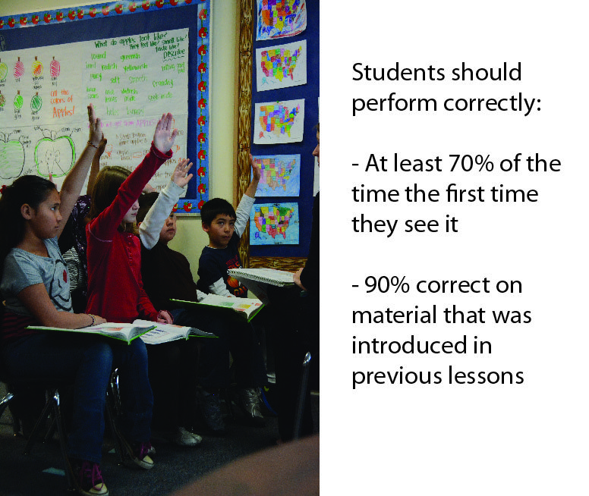
The 4 Things I Look for in a Direct Instruction Classroom
Notes:
There are different criteria for material that is new – never seen by the kids before today’s lesson – and material that was introduced in previous lessons. Even the new stuff is not totally new, and new items are introduced by modeling – you telling them the answer – like this sound is “p”, what sound? So they should get new things correct more often than incorrect even for things that are new.
I calculate these percentages by counting 10 tasks and keeping track of how many responses kids got correct THE FIRST TIME THEY RESPONDED to the item, and how many they got wrong. If they get 7 or more out of 10 correct on new material and 9 or more correct on review material, then they are placed correctly. If they get less, the material is too difficult for them, and they will have trouble mastering the material in a reasonable time. If it’s more, they may be underplaced and ready for more challenging material.
Again, these numbers relate to student responses BEFORE correcting students and telling them the answer.

Slide 15
The 4 Things I Look for in a Direct Instruction Classroom
Is instruction effective – do students master the material?
Proper Placement
Student Engagement
Notes:
So the first thing I look for – student engagement.
The 2nd thing I look for – proper placement.
The 3rd most fundamental question: Do students master the material? Are they able to respond correctly after the teacher/co-teacher has corrected all the errors? So when you have given them the answer if they make a mistake, and you repeat the format from the top, do all students answer correctly on every item the last time through?
In terms of the stair step, does it appear that students are firmly on the step for this lesson and ready to take the next step during the next lesson? If not, students will have to repeat the parts that they haven’t mastered.
I said previously that the first-time correct tells you whether they already know the material. The final run-through tells you whether they seem to know all of it after corrections. We don’t know if they will retain the information until the next day. We’ll find out the next day. But it is important that they know the material now. By the end of this lesson.
So when I go into classrooms, I watch to see whether all student errors are being corrected and the material is repeated with students answering correctly the last time through.

Slide 16
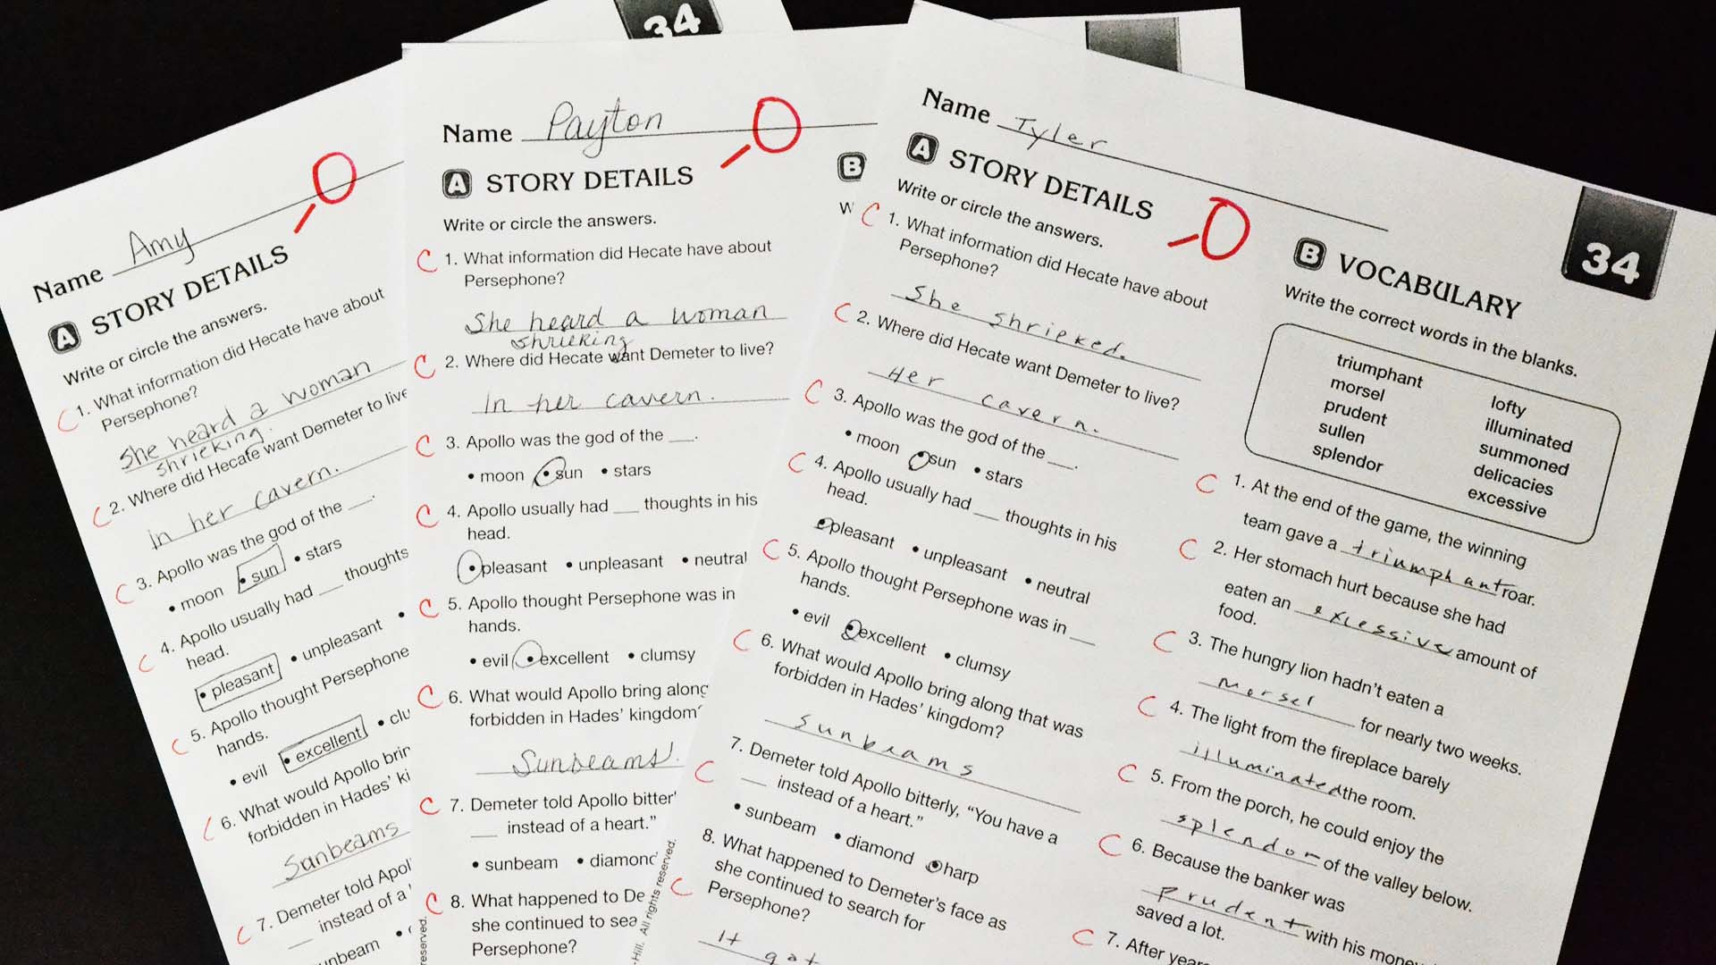
The 4 Things I Look for in a Direct Instruction Classroom
Notes:
An excellent way to determine whether instruction is effective – whether students are at mastery – is how well students perform on their independent work. Some time passes between error correction during instruction and independent work time. So you can see how much students have retained since you corrected the last error.
If they demonstrate a high degree of mastery on their independent work, like these three kids who got all of the items correct, then you can be pretty sure that they’ll be able to remember a lot of the material for the next instructional period. (As long as they didn’t copy their work from another student like the girl in the earlier slide.)
So I love to look at independent work to see what percentage students got right, and whether fix-ups are being done and checked by the teacher. It provides a great check on whether instruction is effective.

Slide 17
The 4 Things I Look for in a Direct Instruction Classroom
Is instruction efficient – is time being used wisely?
Effectiveness of Instruction
Proper Placement
Student Engagement
Notes:
So the first thing I look for – The 2nd thing…The 3rd thing...
The last question: How efficient is instruction? Efficiency has to do with time. Are the students not only learning the material, but are they learning it at a reasonable rate that will allow them to complete at least a year’s worth of material in a year’s time?
We want students to master material, but we don’t want it to take too long. Instruction can be highly effective but not desirable at all. If it takes two weeks for students to master a lesson, instruction is effective but not efficient. We want them to progress through the program at mastery at a reasonable rate.
At the same time, the rate at which students complete lessons only makes sense if they master the material as they go. Remember the stair-step design. If students progress through the program without mastering the content, then the gap between what they know and what they are supposed to learn each lesson gets larger and larger. The step or amount they have to learn that’s new will not consist of 10-15% of the lesson, but much more. Students won’t be able to master the material in a reasonable amount of time if they are placed in material that is way too difficult for them and master the material as they go. They will need to be re-placed in a spot in the program where they can be successful and repeat the material they didn’t master. When they have to repeat material, time will be lost.

Slide 18

The 4 Things I Look for in a Direct Instruction Classroom
Notes:
So the last thing I look for when I go into classrooms is time-efficiency: Are classrooms set up to allow easy flow and access of materials? Does instruction start on time and last the full period? Are transitions between instructional groups smooth and fluent? Are transitions between lessons smooth and fluent? How does the lesson seem to be progressing?

Slide 19
The 4 Things I Look for in a Direct Instruction Classroom
Efficiency
of Instruction
Effectiveness of Instruction
Proper Placement
Student Engagement
Notes:
QUIZ TIME. Check for understanding!
Now I’m going to see if you’ve mastered the four components of DI I look for when I go into a classroom.
Let’s start at the bottom of the pyramid because that lays the foundation for the other components.
I’m going to divide you into halves. This side gets the first one. Wait until my signal. No jumping the signal.
The first thing I look for is… (signal)
next
Excellent job! Now, you’ll notice that Effectiveness lies below Efficiency. That’s because mastery must always precede acceleration.
3 things about this pyramid. The first is that it’s student-focused.
This is the part that should provide some of you who have observer anxiety some relief. Each one of these categories has to do with what students can or cannot do. Are students placed properly…
I know it may not be easy to have folks come in and watch you teach. But when observers look at the students first. If they’re engaged, then nothing needs to be changed. If they aren’t engaged, look at the teachers to see what’s going on. What you do DOES MATTER, in a big way! But only as it relates to what the kids are doing.
This should give you some relief that we aren’t just looking at form, that you need to meet some sort of arbitrary, artificial model of teaching just because that’s the way we say it should be done.

Slide 20
The 4 Things I Look for in a Direct Instruction Classroom
Some sayings regarding effectiveness of instruction coming first:
Lesson progress without mastery is not progress at all.
Accuracy (in reading, math facts, etc.) before fluency.
Student mastery of lessons now provides for accelerated learning later.
Notes:
So on our pyramid, teaching to mastery is more fundamental than efficiency. Here are some sayings that drive that point home, which you may have heard before. They sound like sayings you might find in fortune cookies.
Let’s say them together.
Lesson progress without mastery is not progress at all. If students don’t master the material, they’ll need to repeat it, which will waste time.
Accuracy (in reading, math facts, etc.) before fluency. If you try to push students too fast, they will make mistakes – in reading, in math, etc. Best to make sure they are accurate first and then try to increase their rate.
Student mastery of lessons now provides for accelerated learning later. If students do master each lesson, each step, there will be opportunities for them to skip steps or go through them much quicker. If they don’t master the lessons, then they will need to be taught step-by-step.
In sum: effectiveness before efficiency.

Slide 21
The 4 Things I Look for in a Direct Instruction Classroom
STUDENT FOCUSED
Efficiency
of Instruction
Effectiveness of Instruction
Proper Placement
Student Engagement
Notes:
3 things about this pyramid. The first is that it’s student-focused.
This is the part that should provide some of you who have observer anxiety some relief. Each one of these categories has to do with what students can or cannot do. Are students placed properly…
I know it may not be easy to have folks come in and watch you teach. But when observers look at the students first. If they’re engaged, then nothing needs to be changed. If they aren’t engaged, look at the teachers to see what’s going on. What you do DOES MATTER, in a big way! But only as it relates to what the kids are doing.
This should give you some relief that we aren’t just looking at form, that you need to meet some sort of arbitrary, artificial model of teaching just because that’s the way we say it should be done.

Slide 22
The 4 Things I Look for in a Direct Instruction Classroom
There is a particular order to the focus of each observation:
Look at student performance / behavior first…
before looking at what the teacher/co-teacher is doing...
to determine what, if anything, needs to be changed.
Notes:
DI is function first, and form only is there if it is demonstrated to meet the function. For instance, a signal is there for what reason? To elicit a crisp group response. If I’m doing a classic signal but it’s not getting a crisp group response, then something needs to change. On the other hand, if I’m doing a completely weird signal, but it’s getting a crisp group response, then that’s great…nothing needs to change.
Some of you may have heard me talk about a para at Fain Elementary in Atlanta doing Sigs K language. Her signal looked awful, but the effect of her signal was terrific – all the kids came in together correctly every time! And she used a teacher-student game that involved toy cars that the kids really responded to. So nothing needed to change.
In contrast, I visited the classroom of a teacher in Gering, NE that everyone said was hot. Her pacing was great, she was perky, she had a classic, clear signal, she corrected errors immediately and followed the firming procedure to make sure that the kids were at mastery. But the kids were only 50% first-time correct. They were not placed correctly, and all of her good form couldn’t fulfill the function of getting these kids to mastery.
So we don’t want you to become robots delivering doses of instruction. We want you to be teachers (and co-teachers) reacting to the students’ performance and providing them with what they need to be successful.

Slide 23
The 4 Things I Look for in a Direct Instruction Classroom
COMPLETENESS
Efficiency
of Instruction
Effectiveness of Instruction
Proper Placement
Student Engagement
Notes:
Two other important things about this pyramid of things to look for during observations.
1) This set of categories of things to look for is complete. It encompasses all the things of importance in a classroom.
Everything can be related to engagement, placement, effectiveness and efficiency of instruction. Thermometer charts? They promote student engagement. Think time? That’s there for efficiency -- to take time to go faster.
This pyramid is DI. If you want to explain to someone what DI is, you can use this pyramid.

Slide 24
The 4 Things I Look for in a Direct Instruction Classroom
COMPLETENESS
TEACHER’S GUIDE
Efficiency
of Instruction
Effectiveness of Instruction
Proper Placement
Student Engagement
Notes:
2nd, this pyramid not only gives observers a guide of what to look at in what order, it provides teachers the order of what to do to make students successful. You should…
make sure that students are engaged and ready for instruction at the start of the period or else your good teaching won’t have an effect. Give positive praise, do a quick response set and award points as soon as possible, vary the pacing. Get them and keep them engaged. Example I observed: _________________________________________________.
be aware of the first-time correct mastery level. If it’s lower than the 70/90%, then there will be trouble. Inform your API. You don’t have to wait until the mastery tests to identify problems. Mastery tests are supposed to provide a check on the effectiveness of teaching. If you see there’s a problem before the mastery test, try to correct it. If you see that the kids already know everything, then they may be ready to be moved up to higher lessons. The learning takes place during the lessons, so if you see an adjustment that needs to be made, tell your API.
In order to ensure effectiveness, correct all errors and teach everything to mastery. Use delayed tests when kids are lining up for recess or during a transition to ensure that all students master the skills and content, because future learning will be built on them. Example I observed: _________________________________________________.
Lastly, use time wisely. Don’t rush things to the point that you or the kids are frantic. It’s important to give them appropriate think time when teaching. But be efficient in your use of time. Example I observed: _________________________________________________.

Slide 25
The 4 Things I Look for in a Direct Instruction Classroom
Notes:
A 5th category that I also look for but didn’t put into the pyramid is kids and teachers being excited and happy. Are kids and teachers enjoying themselves?
If all the things I’ve mentioned are in place, students will feel good about themselves. They will feel good about their abilities, their chances of success, their future, their classroom and their school.
And you will feel good – or should feel good -- about yourselves, too. Hey, I know this is tough work – presenting, correcting, paying attention to all the kids, motivating them, checking their work – for hours!
But if you are successful, you will be doing something that no other person in society – no parent, no social worker, no government employee, no policeman, fireman, lawyer or doctor or anyone else can do – to give these kids the skills they need to be successful in life and the confidence that they can learn whatever they need to learn to reach their goals in life.

Slide 26
Kurt Engelmann’s contact info
Email: kengel@nifdi.org | Toll-free Phone: 1-877-485-1973 x 119
Web: www.nifdi.org | Fax: 541-683-7543
Notes:
And it’s my pleasure to be able to stand in front of you today and tell you that – from what I’ve been able to observe – many of you are well on your way to be able to do these great things for your kids.
Keep up the good work! And feel free to drop me a line.
Thank you all very much for listening.

